Slide 1
Customizable SWOT Analysis Template
www.crayon.co

Slide 2
4 Steps to Build a SWOT Analysis
Build Your SWOT Team: Assemble a team of individuals whose knowledge most closely aligns with your goal.
Establish a Purpose or Objective: Why are you conducting a SWOT analysis? Know which data you’re looking to gather during your research.
Conduct Thorough Research: Identify your strengths, weaknesses, opportunities, and threats.
Create Your SWOT: List out your strengths, weaknesses, opportunities, and threats in a SWOT quadrant.
www.crayon.co

Slide 3
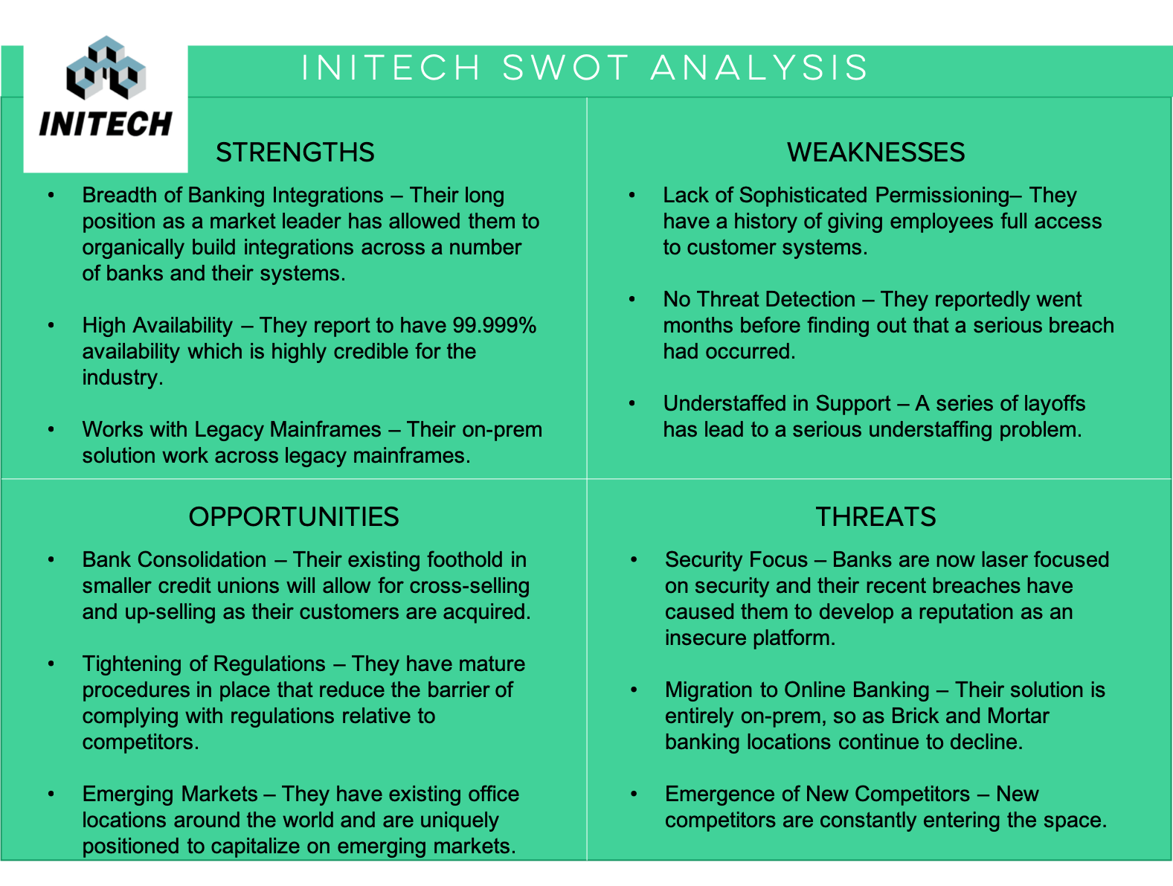
SWOT EXAMPLE
www.crayon.co

Slide 4
*COMPANY NAME* SWOT ANALYSIS
LOGO HERE
STRENGTHS
WEAKNESSES
STRENGTH #1
STRENGTH #2
STRENGTH #3
WEAKNESS #1
WEAKNESS #2
WEAKNESS #3
OPPORTUNITIES
THREATS
OPPORTUNITY #1
OPPORTUNITY #2
OPPORTUNITY #3
THREAT #1
THREAT #2
THREAT #3
www.crayon.co

